Slide 1

HEART DIESEASE

Slide 2
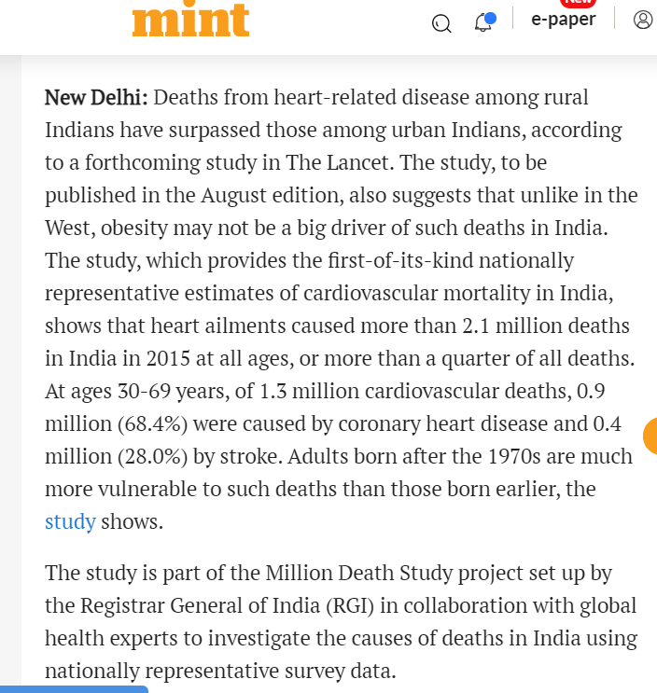
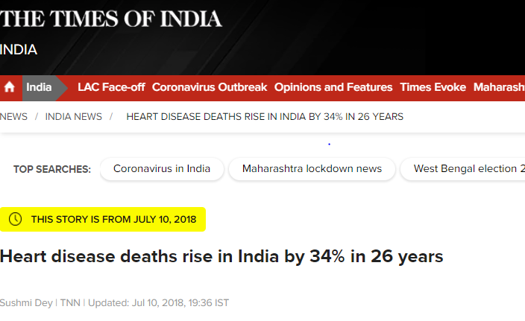
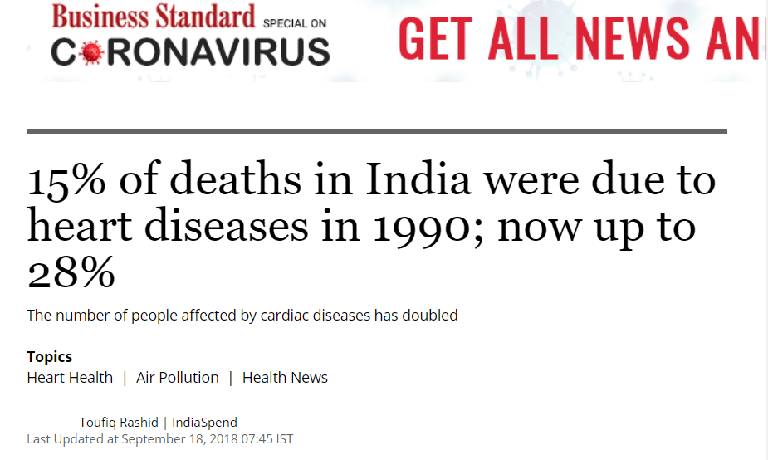

Slide 3

PROBLEM STATEMENT
To predict the possibility of having heart disease
non-invasively?

Slide 4

EXISTING SCENARIOS

Slide 5

CASE STUDY

Slide 6


Slide 7


CHALLENGES
Improving quality of analytical data
Using data to improve experiences

Slide 8
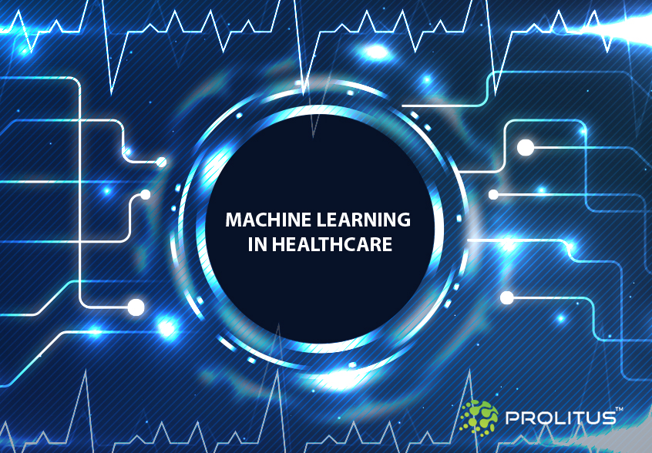
BENIFITS
1.Heart Disease Pre-Diagnosis Tool
2. Smart Health Record
3. Generic Diseases Prediction Models

Slide 9


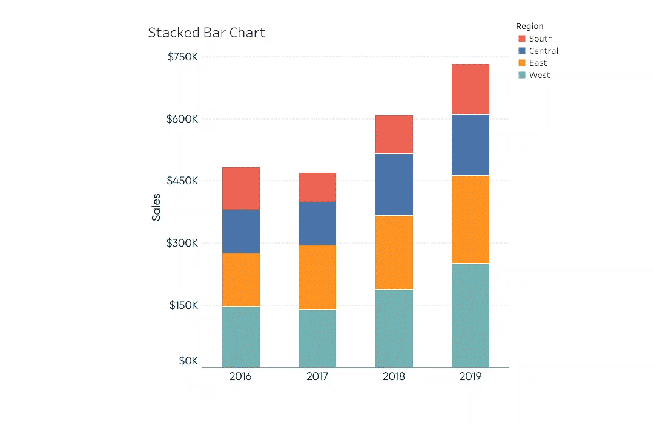

ARCHITECTURE DIAGRAM
Data Analysis(Machine Learning)
Data Sources
(Patient reports)
Data Warehouse
Reporting
Tableau/Power BI

